Slide 1
Boot to USB
If you have an HP: F9 when booting
If you have a Dell: F12 when booting
Otherwise, BIOS
Choose Forensics Mode at the prompt

Slide 2
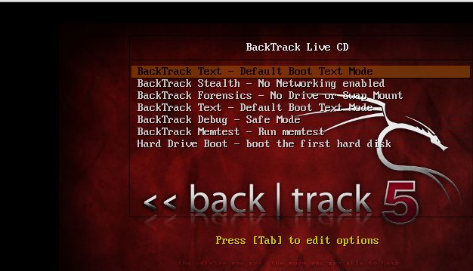
BackTrack 5R3 Interface

Slide 3
md5deep
Use terminal (black and white box)
md5deep [evidence drive as detected]
Ex:
md5deep /dev/sdc

Slide 4
dd
Use terminal to enter commands
Ex:
dd if=/dev/sdc of=evidence.raw

Slide 5
mount
Use terminal
Create a directory in /mnt
Ex:
sudo mkdir /mnt/drive
In terminal Ex:
sudo mount /dev/sdc /mnt/drive

